Slide 1
Social Analysis

Slide 2
Prayer

Slide 3
At the end of the session, the students would have been able to:
Develop the capacity for analytical and systemic thinking through the use of the Sustainable Livelihood framework
To be able to explain key issues and realities in the community and the sector

Slide 4
What is social analysis?
a systemic process towards social awareness
an attempt to discover the cause of the problems and establish the relationship among these factors
As a framework of analysis, it is both objective (an empirical verification) and subjective (choice of framework of analysis)
the effort to obtain a more complete picture of a situation by exploring its historical and social structural relationships

Slide 5
Why do social analysis?
a way to get the pastoral cycle learning process going
In seeing the bigger picture, we hope to realize that we all share a responsibility for other people especially the marginalized

Slide 6
What is the sustainable lives framework?
provides an organized checklist of important issues and sketches out the way these issues are linked with each other
Emphasizes the multiple interactions between the various factors which affect the lives and livelihoods of communities
It starts from people’s everyday experiences, and uses information to build up a picture of capability/assets

Slide 7
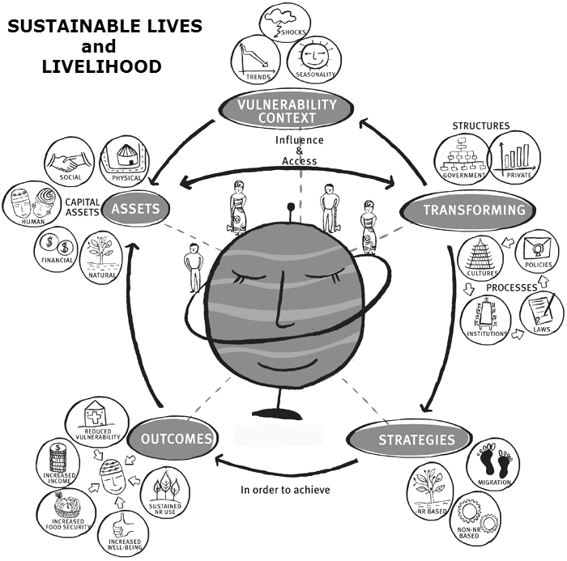

Slide 8
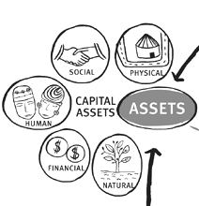

Slide 9
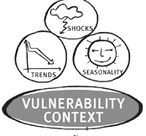

Slide 10
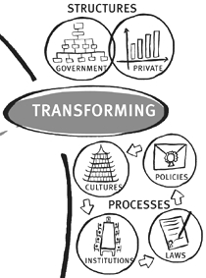

Slide 11
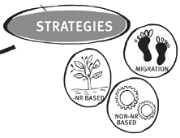

Slide 12
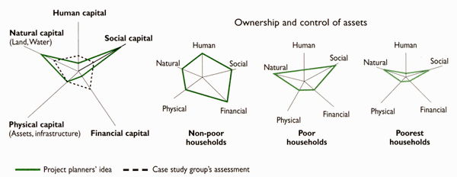
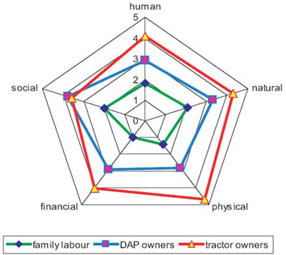
ASSET PENTAGON

Slide 13
HUMAN asset
Human asset represents the skills, knowledge, ability to labour and good health that together enable people to pursue different adaptive strategies and achieve their life objectives
How does household composition vary by socio-economic status?
What skills, capacity, knowledge and experience do different household members have?
From where (what sources, networks) do people access information that they feel is valuable to their adaptive strategies?

Slide 14
SOCIAL asset
the social resources upon which people draw in pursuit of their life objectives
Could mean :
Networks and connectedness
Membership of more formalise groups
Relationships of trust, reciprocity and exchange
What links does the household have with other households or individuals in the community and how does these links become important?
Notes:
There is much debate about what exactly is meant by the term ‘social capital’. In the context of the sustainable livelihoods framework it is taken to mean the social resources upon which people draw in pursuit of their livelihood objectives. These are developed through:
• networks and connectedness, either vertical (patron/client) or horizontal (between individuals with shared interests) that increase people’s trust and ability to work together and expand their access to wider institutions, such as political or civic bodies;
• membership of more formalised groups which often entails adherence to mutually-agreed or commonly accepted rules, norms and sanctions; and
• relationships of trust, reciprocity and exchanges that facilitate co-operation, reduce transaction costs and may provide the basis for informal safety nets amongst the poor.

Slide 15
NATURAL asset
Natural resource stocks from which resource flows and services useful for adaptive strategies are derived
What land, water, livestock, and plant or forest resources do household members use inside and outside the village? What do they use them for?
What are the terms of access and exchange
Notes:
Within the sustainable livelihoods framework, the relationship between natural capital and the Vulnerability Context is particularly close. Many of the shocks that devastate the livelihoods of the poor are themselves natural processes that destroy natural capital (e.g. fires that destroy forests, floods and earthquakes that destroy agricultural land) and seasonality is largely due to changes in the value or productivity of natural capital over the year.

Slide 16
PHYSICAL asset
Physical asset comprises the basic infrastructure and producer goods needed to support adaptive strategies
What infrastructures do household members have access to? What infrastructures do they have no access to and why?
What tools or equipment do household members use during different livelihood activities and what are the terms of access to them?
Notes:
Many participatory poverty assessments have found that a lack of particular types of infrastructure is considered to be a core dimension of poverty. Without adequate access to services such as water and
energy, human health deteriorates and long periods are spent in non-productive activities such as the collection of water and fuel wood. The opportunity costs associated with poor infrastructure can preclude education, access to health services and income generation

Slide 17
FINANCIAL asset
financial resources that people use to achieve their life objectives.
What are their sources of finance?
How reliable are inflows of finance? Do they vary by season?
Who controls income/earnings when it arrives? How is it used?
Notes:
Financial capital is probably the most versatile of the five categories of assets.
• It can be converted – with varying degrees of ease, depending upon Transforming Structures and Processes – into other types of capital.
• It can be used for direct achievement of livelihood outcomes – for example when food is purchased to reduce food insecurity.
• Rightly or wrongly, it can also be transformed into political influence and can free people up for more active participation in organisations that formulate policy and legislation and govern access to resources.
However, it is also the asset that tends to be the least available to the poor. Indeed, it is because the poor lack financial capital that other types of capital are so important to them.
There are, in addition, assets or desirable outcomes that may not be achievable through the medium of money (such as different components of well-being and knowledge of human rights).

Slide 18
Asset pentagon
The shape of the pentagon can be used to show schematically the variation in people’s access to assets. The idea is that the centre point of the pentagon, where the lines meet, represents zero access to assets while the outer perimeter represents maximum access to assets.
After listing down all observations pertaining to the pentagon asset, rate the communities’ asset pentagon.

Slide 19
PLENARY DISCUSSION

Slide 20
Why is it important?
HUMAN - As well as being of intrinsic value, human capital (knowledge and labour or the ability to command labour) is required in order to make use of any of the four other types of assets.
SOCIAL – facilitates innovation, development and sharing of knowledge.
NATURAL – None of us would survive Without the help of key environmental services and food produced from natural capital.

Slide 21
Why is it important
PHYSICAL – Without adequate access to services, long periods are spent in non-productive activities. Poor infrastructures lead to high opportunity cost .
FINANCIAL
It can be converted
It can be used for direct achievement of livelihood outcomes
Rightly or wrongly, it can also free people up for more active participation

Slide 22
VULNERABILITY CONTEXT

Slide 23
Vulnerability context
The Vulnerability Context frames the external environment in which people exist. People’s adaptive strategies and the wider availability of assets are fundamentally affected by critical trends as well as by shocks and seasonality – over which they have limited or no control.
Look into past conversations with the people in the area, recall immediate and distant vulnerabilities that affects the people in the area (and the sector)
Notes:
Shocks can destroy assets directly (in the case of floods, storms, civil conflict, etc.). They can also force people to abandon their home areas and dispose of assets (such as land) prematurely as part
of coping strategies. Recent events have highlighted the impact that international economic shocks, including rapid changes in exchange rates and terms of trade, can have on the very poor.
Trends may (or may not) be more benign, though they are more predictable. They have a particularly important influence on rates of return (economic or otherwise) to chosen livelihood strategies.
Seasonal shifts in prices, employment opportunities and food availability are one of the greatest
and most enduring sources of hardship for poor people in developing countries.

Slide 24
Relation to other part of the framework
Asset Pentagon: The vulnerability context can either destroy or create assets
Transforming structures & processes: the structures and processes also directly impact the resilience or adaptability of the people to the various vulnerabilities abounding them. Even if these are out of their control, if the structures are able to cushion its effects, the people will be able to recuperate faster.
To manage the Vulnerability Context is to help people to become more resilient and better able to capitalise on its positive aspects
Notes:
Understanding the nature of vulnerability is a key step in sustainable lives analysis. Effort can then be concentrated on understanding the impact of these factors and how they can be minimized.

Slide 25
PLENARY DISCUSSION

Slide 26
Transforming structures and processes

Slide 27
Transforming structures and processes
Structures are the organisations, both private and public, that set and implement policy and legislation, deliver services, purchase, trade and perform all manner of other functions that affect life outcomes
Process determine the way in which structures and individuals operate and interact.
Identify various structures and processes that you observed in your area (or the sector)

Slide 28
Relationships within the framework
Processes (policies), established and implemented through structures, affect trends both directly and indirectly. They can also help cushion the impact of external shocks.
Structures and processes have direct influence on how people will be able to access their resources, the returns and exchange for these. Thus, it will affect the decline or increase of their various assets.

Slide 29
Adaptive strategies

Slide 30
Adaptive strategies
What are the combinations of activities that the community does to support themselves?
Which combinations of activities appear to be ‘working’ best?
Is there any discernible pattern of activities adopted by those who have managed to escape from poverty?

Slide 31
Adaptive Strategies
ways in which people combine their assets to support themselves and their families, and the decisions and choices that they make within the context in which they live
Range and combination of activities and choices that people make/undertake in order to achieve their life goals
It is affected by
Diversity of assets
Amount of assets
Balance between assets

Slide 32
PLENARY DISCUSSION

Slide 33
As a conclusion...
As a person’s assets increase, they are better able to protect themselves from shocks and their vulnerabilities decrease. In the idea of the ‘life outcome ladder’, as a person builds their asset-base their position on the ladder moves up, but if they subsequently lose assets (for whatever reason) they risk falling back down the ladder.

Slide 34
Life outcome ladder

Slide 35
SURVIVING (Life outcome X ; Sustainable X)
Life is a constant battle
Very vulnerable to any external shocks
No choice or flexibility
Total Reliance on benefits
Likely in debt with high interest credit
Isolation – few social assets
Reduced consumption (food, transport, etc)

Slide 36

COPING (Life outcome X ; Sustainable )
Getting by juggling
Can cope with minor shocks
Very limited choice and flexibility
Total/partial reliance on benefits
Informal economy
Social assets are very important
SURVIVING (Life outcome X ; Sustainable X)

Slide 37
ADAPTING (Life outcome X ; Sustainable X)
Life isn’t bad
Vulnerable to shocks (reduced benefits)
More choice and flexibility but still limited
Has moved into formal economy (minimum wage)
Personal assets, social assets are undermined
COPING (Life outcome X ; Sustainable )
SURVIVING (Life outcome X ; Sustainable X)

Slide 38
ACCUMULATING (Life outcome X ;
Sustainable X)
Life is going well
Can cope with external shocks
Range of choices, very flexible
Works in formal economy
Accumulating assets
Home ownership
ADAPTING (Life outcome ; Sustainable X )
COPING (Life outcome X ; Sustainable )
SURVIVING (Life outcome X ; Sustainable X)

Slide 39
In seeing the sustainable lives framework…
In what ways are the community marginalized?
As students, how do you think you can help in strengthening the asset pentagon of the community?

Slide 40
The sustainable lives approach values social sustainability, inclusion and equity and prioritises the interests of the poor. But the poor are themselves a heterogeneous, and internally competitive, grouping. There is no ‘solution’ to this problem. HOWEVER...

Slide 41
However, its existence does underscore the importance of:
extending choice and opportunities for the poor and building up their ability to take advantage of these opportunities (through building capital assets) while leaving them to make the final choice of what they will do; and
thinking about safety nets for those who remain unable to achieve their livelihood objectives in what will always be a competitive environment.

Slide 42
http://eapi.admu.edu.ph/eapr99/chap5.htm
Holland, Joe and Peter Henriot, S.J. Social Analysis: Linking Faith and Justice. Rev. Ed.
Maryknoll: Dove Communications, Orbis Books, and Center of Concern, 1983.
Conference for Mercy Higher Education (CMHE) Introducing Students to Social Analysis and Theological Reflection: Foundations for Facilitators of Service-Learning at Colleges and Universities. Nebraska: Jennifer Reed-Bouley and Ken Reed-Bouley, 2007 http://www.mercyhighered.org/documents/guide3.pdf last accessed June 22,2012
Council of Churches for Great Britain and Ireland (CCBI), Unemployment and the Future of Work. London, 1987
Heaney, T. Issues in Freirean Pedagogy, 1985 http://www3.nl.edu/academics/cas/ace/resources/Documents/FreireIssues.cfm last accessed June 22, 2012
Sustainable Livelihoods Guidance Sheets." Department of International Development, Apr. 1999. Web. 1 June 2012. <http://www.eldis.org/vfile/upload/1/document/0901/section2.pdf>.
The Sustainable Livelihoods Handbook : An Asset-based Approach to Poverty. Great Britain : Church Action on Poverty and Oxfam, 2009

